Slide 1
Introduction to Evolution Strategy（进化策略） & Evolutionary Programming（进化规划）
Yong Wang
School of Automation
Central South University
ywang@csu.edu.cn
https://intleo.csu.edu.cn/

Slide 2
Outline of My Talk
Evolution Strategy (ES)
Evolutionary Programming (EP)

Slide 3
Outline of My Talk
Evolution Strategy (ES)
Evolutionary Programming (EP)

Slide 4



Evolution Strategy (ES)
ES was proposed by I. Rechenberg and H.-P. Schwefel in 1964
There are several versions（版本） of ES, for instance（例如）
  ( )-ES
  ( )-ES
µ parents
offspring
µ parents
µ parents
µ parents
µ parents and
offspring

Slide 5
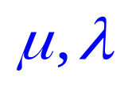
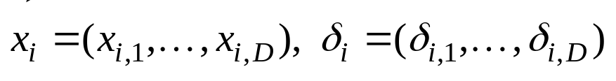
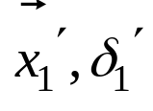
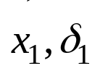
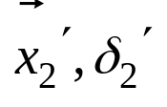
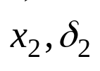
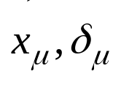
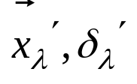
The Framework of ( )-ES
Selection
Crossover
Mutation
fitness function
（适应度函数）
Algorithmic framework
（算法框架）

Slide 6
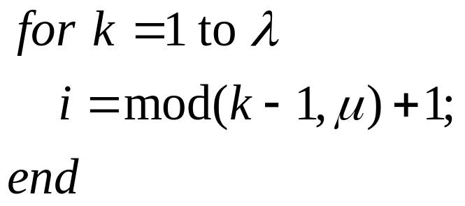
Selection & Crossover
Selection
Crossover

Slide 7
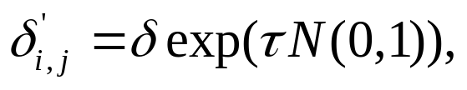



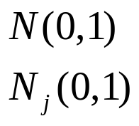
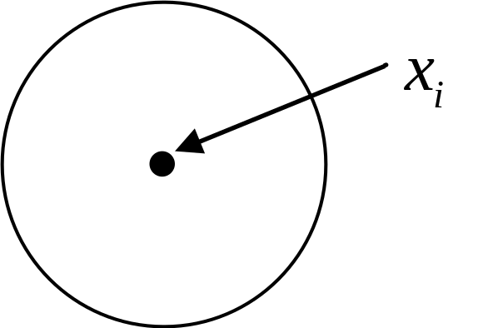
Mutation (1/3)
Normal distribution

Slide 8





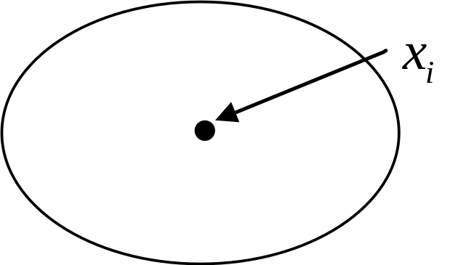
Mutation (2/3)

Slide 9






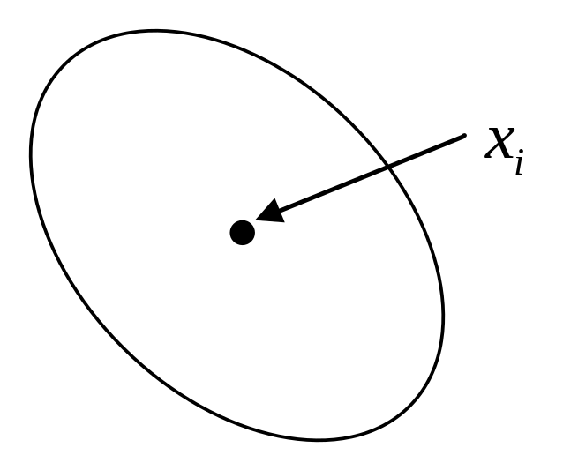
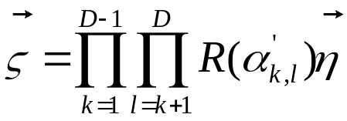



Mutation (3/3)
rotation angle
a parameter

Slide 10
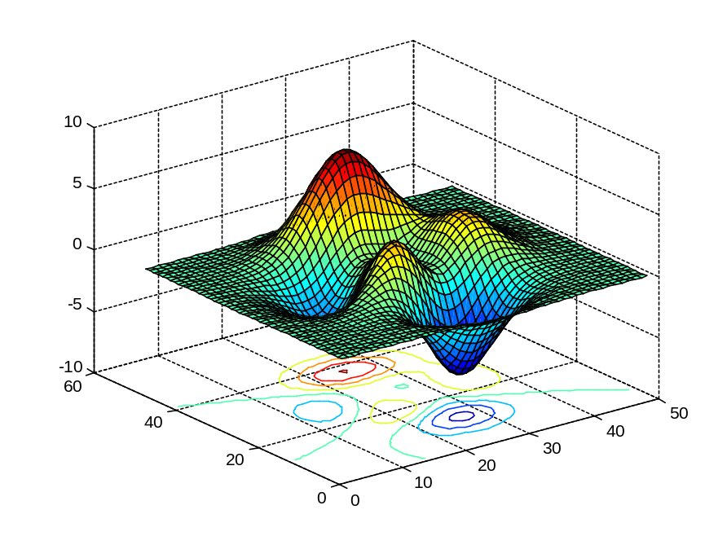
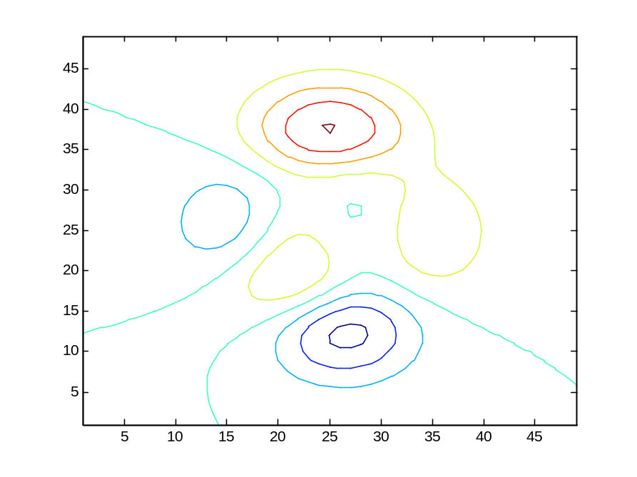
An Example
Contour（等高线）

Slide 11

Covariance Matrix Adaptation Evolution Strategy（协方差矩阵自适应进化策略）
In addition to ( )-ES and ( )-ES, an advanced version of ES has been proposed by N. Hansen
  Covariance matrix adaptation ES (CMA-ES)
Currently, CMA-ES is the most well-known ES
http://www.cmap.polytechnique.fr/~nikolaus.hansen/
N. Hansen and A. Ostermeier. Completely derandomized self-adaptation in evolution strategies. Evolutionary Computation, vol. 9, no. 2, pp. 159-195, 2001.

Slide 12

The Main Idea of CMA-ES (1/3)

Slide 13
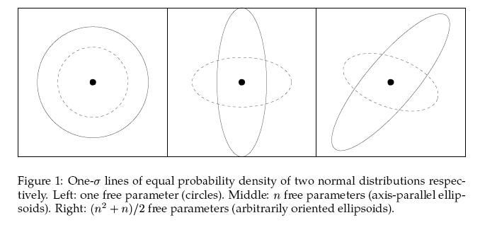
The Main Idea of CMA-ES (2/3)
Contour（等高线）
An Example

Slide 14
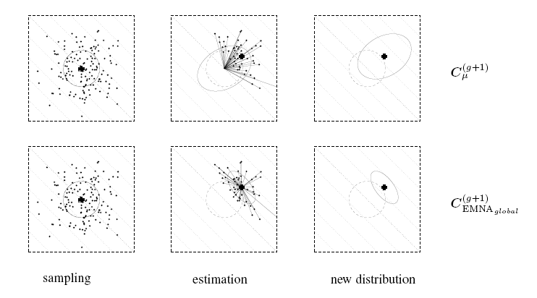
The Main Idea of CMA-ES (3/3)
Rank-μ-Update

Slide 15
Outline of My Talk
Evolution Strategy (ES)
Evolutionary Programming (EP)

Slide 16
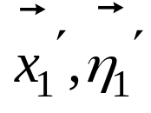
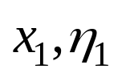
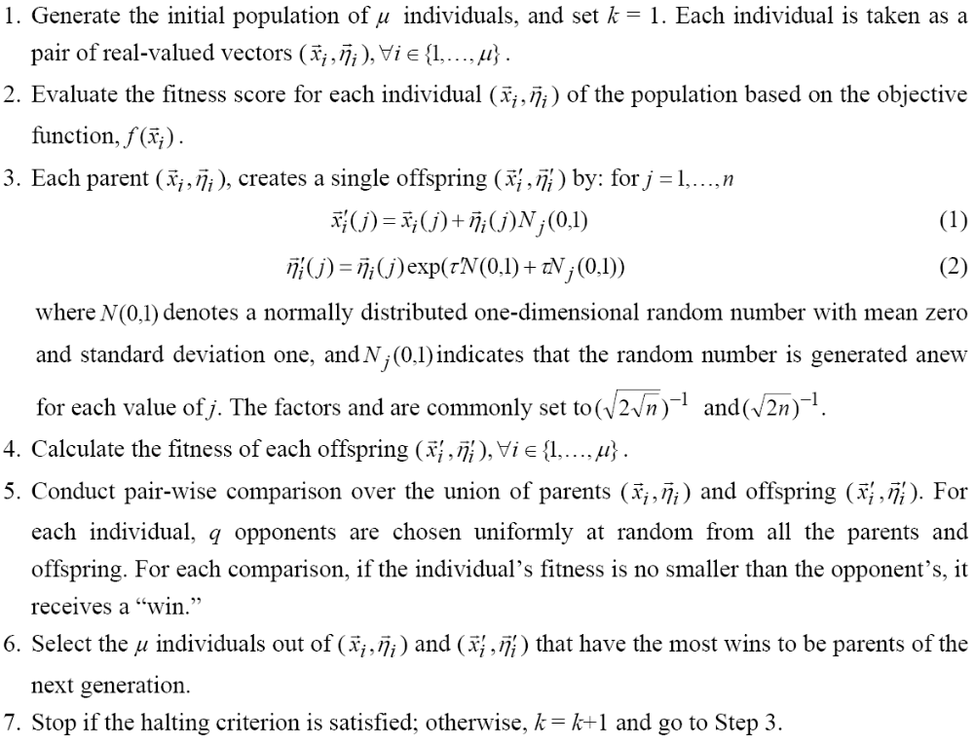
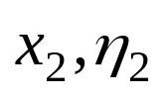
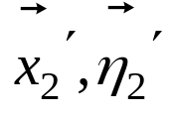
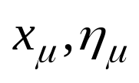
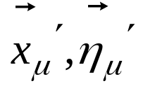
Evolutionary Programming (EP)
EP was proposed by L. J. Fogel in 1966
fitness
function
fitness
function
Reference set
Algorithmic framework

Slide 17
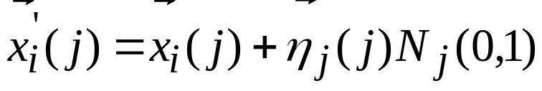
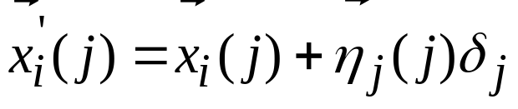
Cauchy Mutation VS Gaussian Mutation
Gaussian distribution
（高斯分布）
Cauchy distribution（柯西分布）
X. Yao, Y. Liu and G. Lin, “Evolutionary programming made faster,” IEEE Transactions on Evolutionary Computation, vol. 3, no. 2, pp. 82-102, 1999.

Slide 18
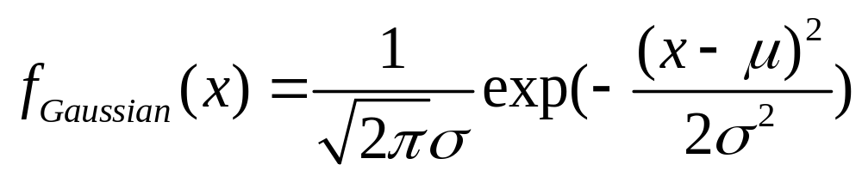
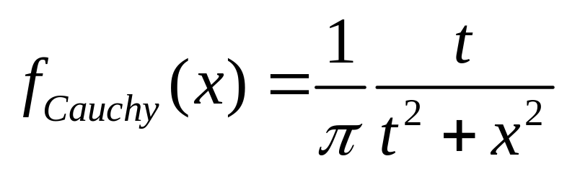
Cauchy Distribution VS Gaussian Distribution (1/2)
Probability density function (PDF，概率密度函数)

Slide 19
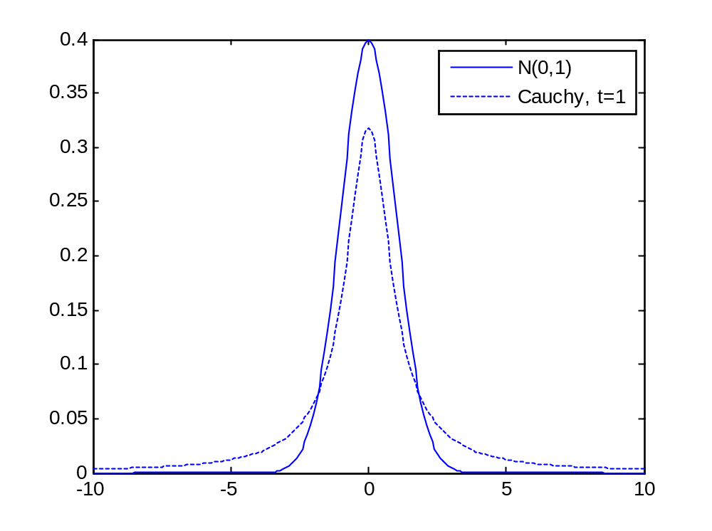
Cauchy Distribution VS Gaussian Distribution (2/2)
amplitude
（幅值）
tail

Slide 20
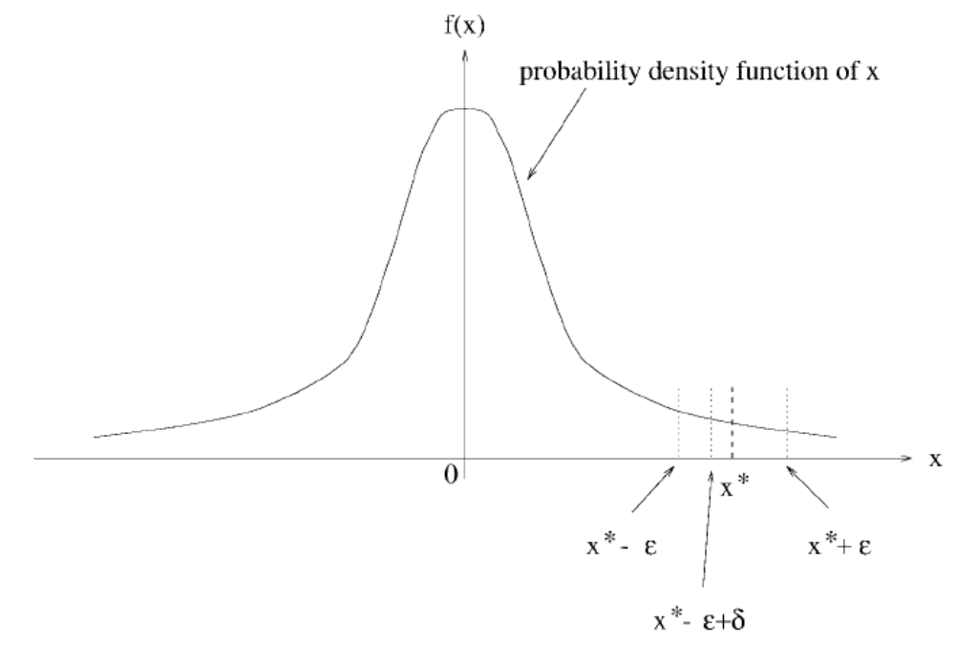
Theoretical Background (1/3)

Slide 21
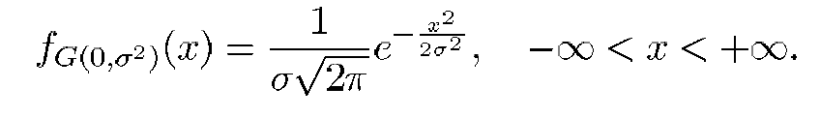
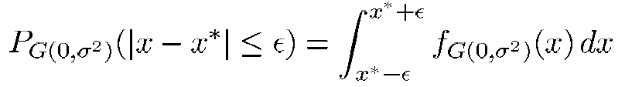
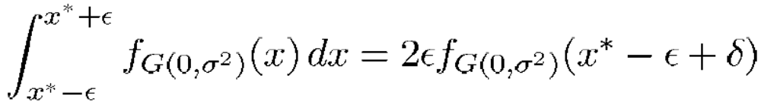
Theoretical Background (2/3)

Slide 22
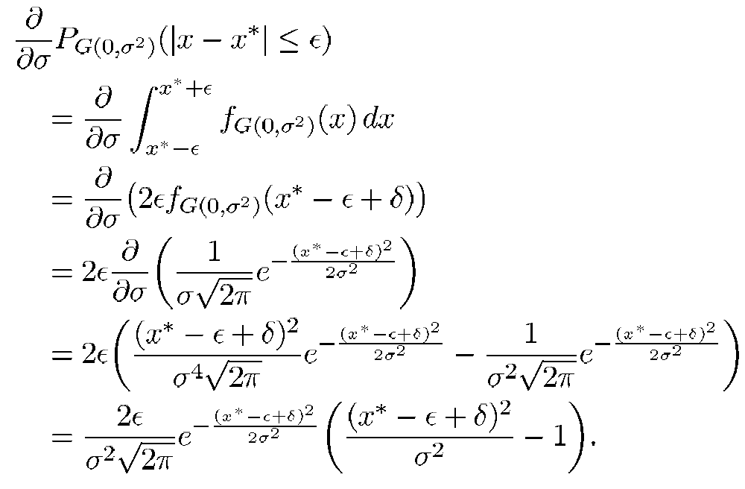
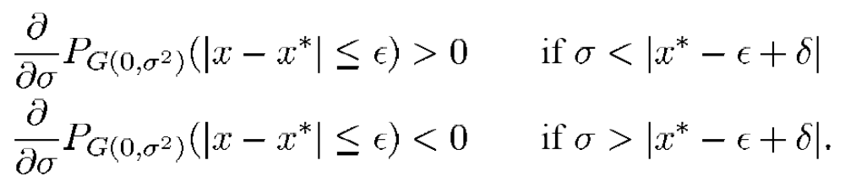
Theoretical Background (3/3)

Slide 23
Thank you very much
for your attention!

